Slide 1


SP3176 The Universe Chapter 5: Through the looking glass
Lim Zhi Han

Slide 2
What is this course about? What did we do and where are we heading?

Slide 3
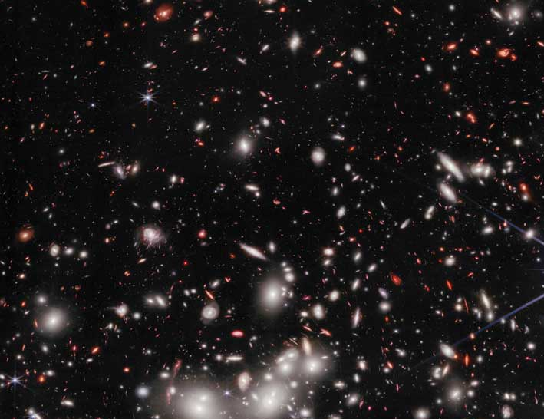
What do we measure?
What do we model?
Kepler, Newton
Position, appearance
(Chapter 1)
Planetary motion (Chapter 1, 2)
Brahe
Fraunhofer
Bohr, Schrödinger
Spectra, composition (Chapter 3, 4)
Galileo
Light, atoms & molecules (Chapter 3, 4)
The Beautiful and Evolving Universe
You!
Planck
Brightness & distance
Chapter 5
Space & time
(Chapter 6)
Einstein
Redshift, temperature etc..
Chapter 5
Expanding Universe (Chapter 7)
Hubble
Leavitt
Humason
FLRW

Slide 4
Pre-lecture homework
Show us your favourite Astronomy Picture of the Day (APOD)

Slide 5
Learning Objectives
At the end of this lesson, you will
understand how distance and other physical quantities are measured in astronomy

Slide 6
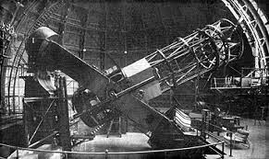
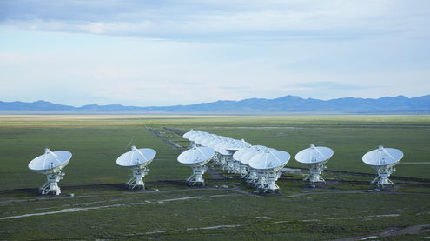
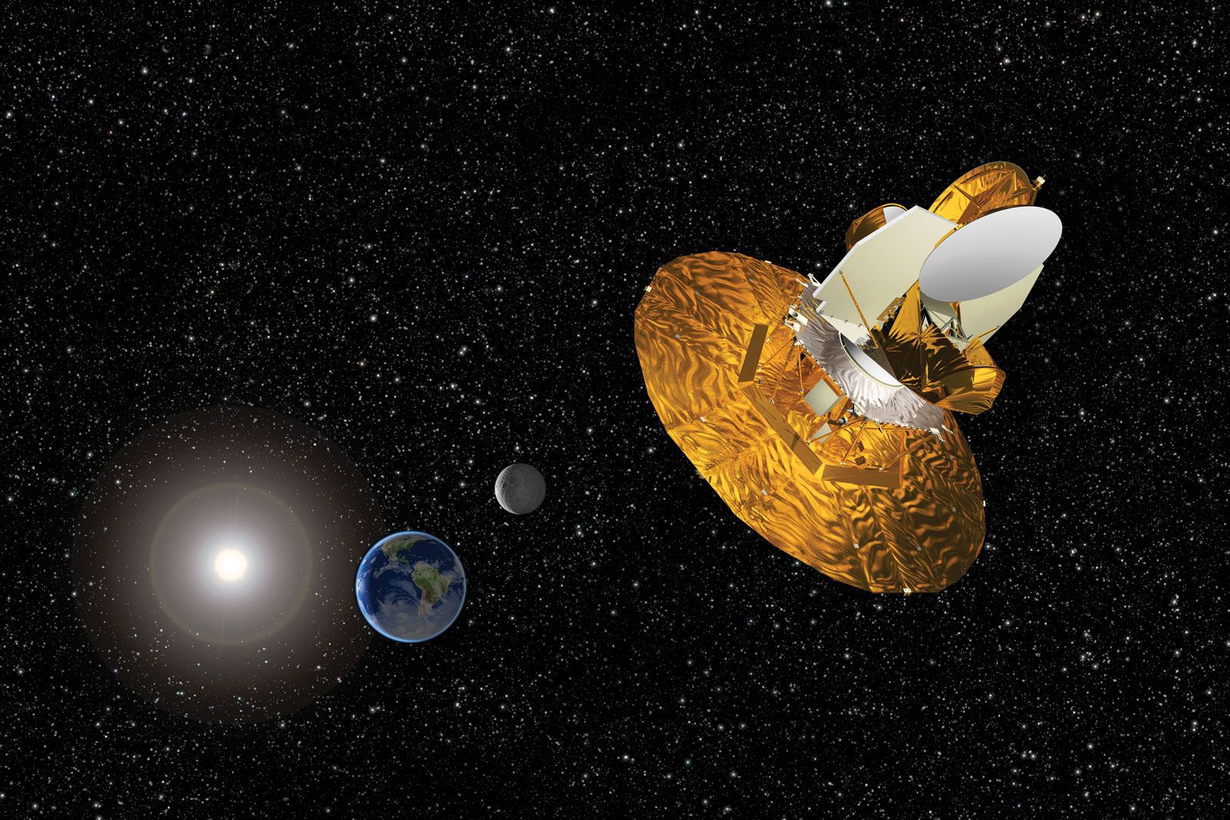
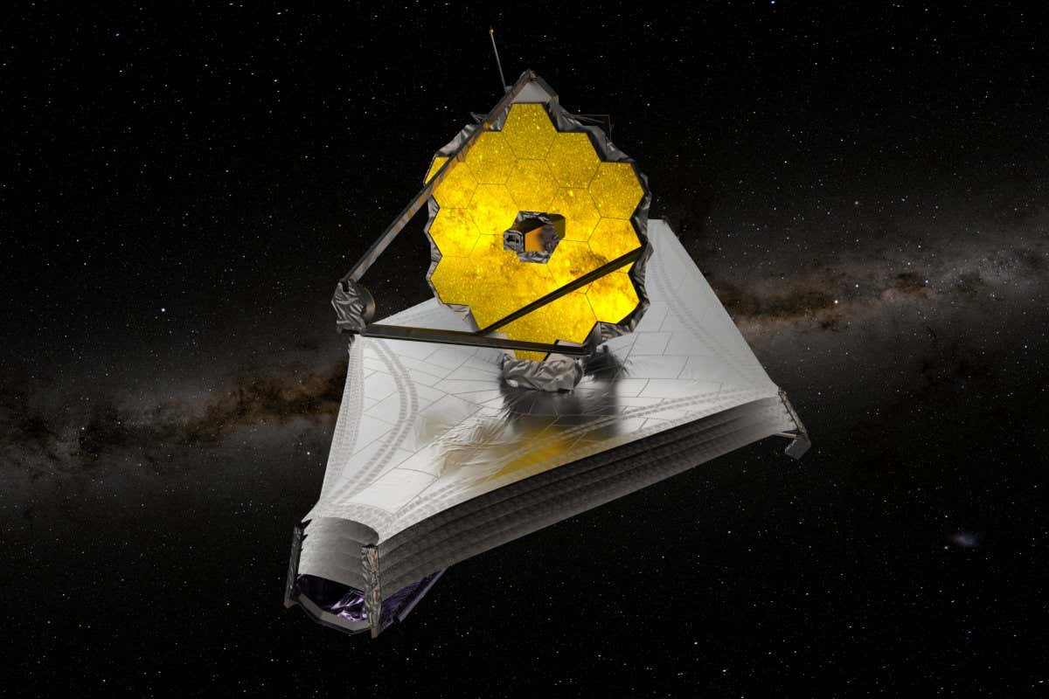
Telescopes
Hubble’s telescope at Mount Wilson
Very Large Array (VLA)
WMAP
James Webb Telescope

Slide 7
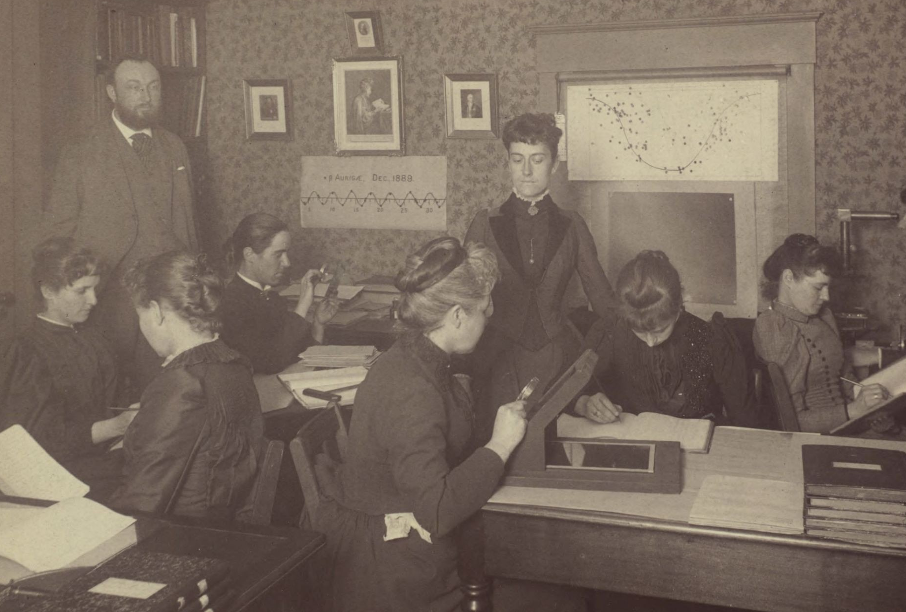
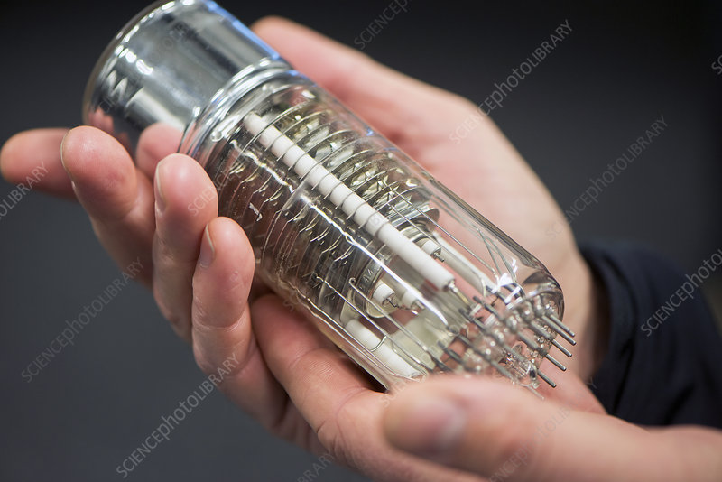
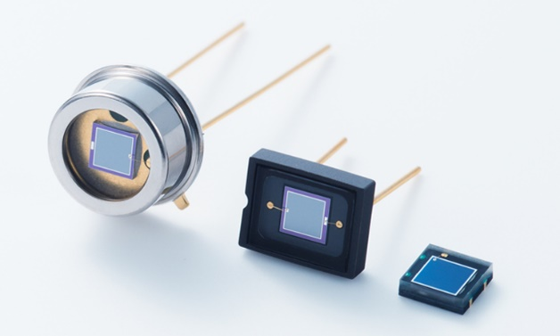
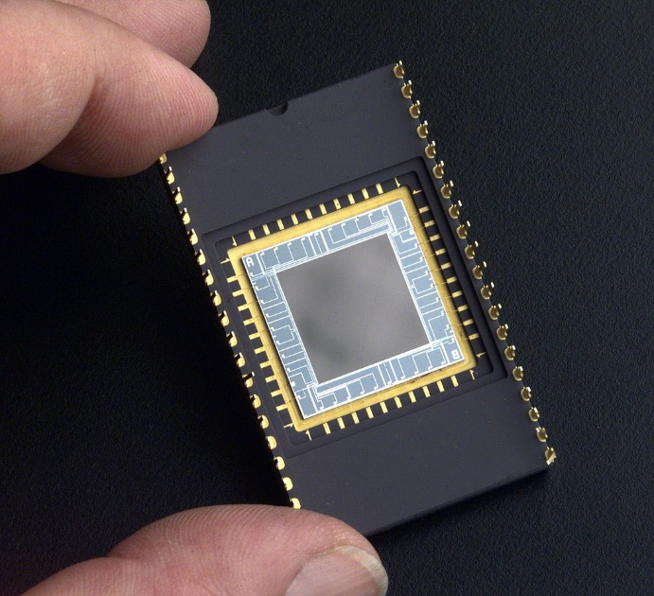
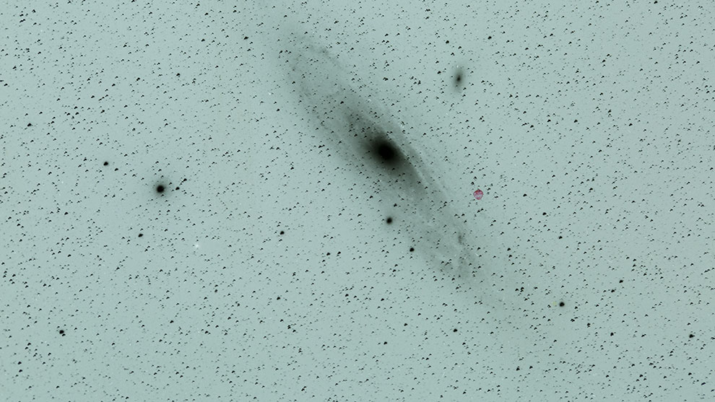
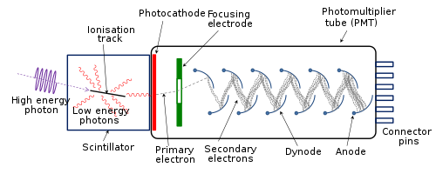
Photometry
Photographic plate
(1880-1960s)
Photomultiplier tube
(1930s-1990s)
Photodiodes, CCD
(1930s-1990s)
Image credits: Harvard University Archives
American Museum of Natural History
Image credits: Science Photo
Qwerty123uiop
Image credits: Hamamatsu
Notes:
https://www.hamamatsu.com/jp/en/product/optical-sensors/photodiodes.html

Slide 8
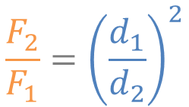
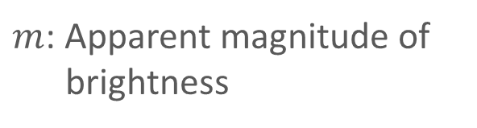
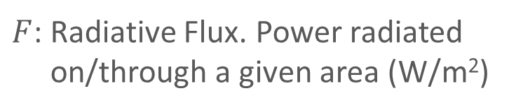
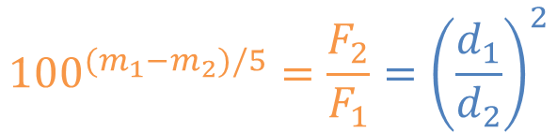
Relating Brightness to Distance
Amount of light detector receives is inversely proportional to the square of distance away from source.
$$\frac{F_{2}}{F_{1}}={\left(\frac{d_{1}}{d_{2}}\right)}^{2}$$
$F$: Radiative Flux. Power radiated on/through a given area (W/m²)
Humans perceive brightness in the logarithmic scale.
$${100}^{{(m}_{1}−m_{2})/5}=\frac{F_{2}}{F_{1}}={\left(\frac{d_{1}}{d_{2}}\right)}^{2}$$
$m$: Apparent magnitude of brightness

Slide 9
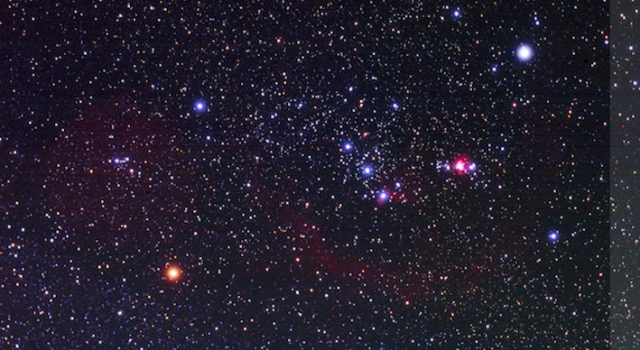
Rigel
m = 0.15
Bellatrix
m = 1.60
m = 2.4
Mintaka
M42 Orion Nebula
Alnilam
m = 1.65
Alnitak
m = 1.85
Saiph
m = 2.05
Betelgeuse
m = 0.87
Image credit: Remus CJ

Slide 10
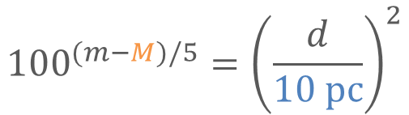
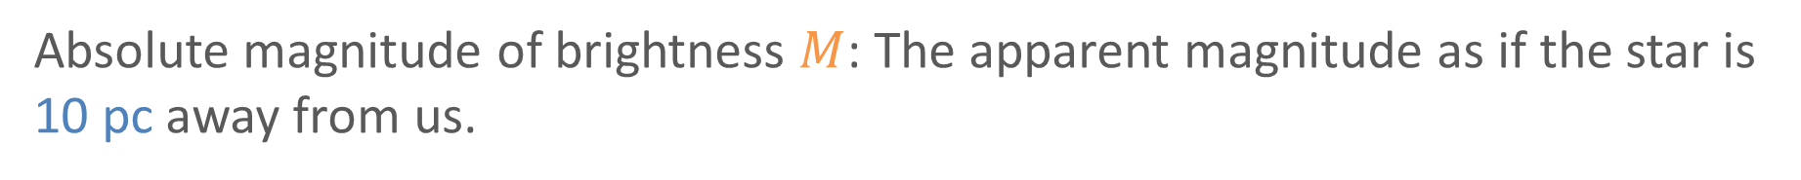
Establish a point of reference
If we can put all stars at the same distance away from us, we can compare their intrinsic brightness.
Absolute magnitude of brightness $M$: The apparent magnitude as if the star is 10 pc away from us.
$${100}^{(m−M)/5}={\left(\frac{d}{10 pc}\right)}^{2}$$

Slide 11
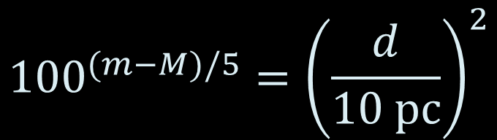
$${100}^{(m−M)/5}={\left(\frac{d}{10 pc}\right)}^{2}$$
Rigel
m = 0.15
M = -6.96
d = 264 pc
Bellatrix
m = 1.60
M = -2.84
d = 77.3 pc
m = 2.4, M = -4.84 , d = 281 pc
Mintaka
M42 Orion Nebula
Alnilam
m = 1.65, M = -7.26, d = 605 pc
Alnitak
m = 1.85, M = -5.15 , d = 251 pc
Saiph
m = 2.05
M = -4.44
d = 199 pc
Betelgeuse
m = 0.87
M = -5.47
d = 153 pc
Image credit: Remus CJ

Slide 12
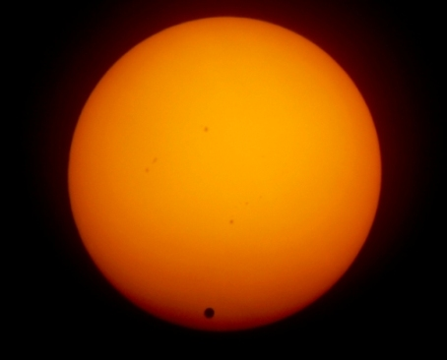
Distance measurement I: Distance to Sun
Distance to the Sun = 1 Astronomical Unit
First measured accurately using the Transit of Venus.
(c)
Details in Appendix of lecture notes.

Slide 13
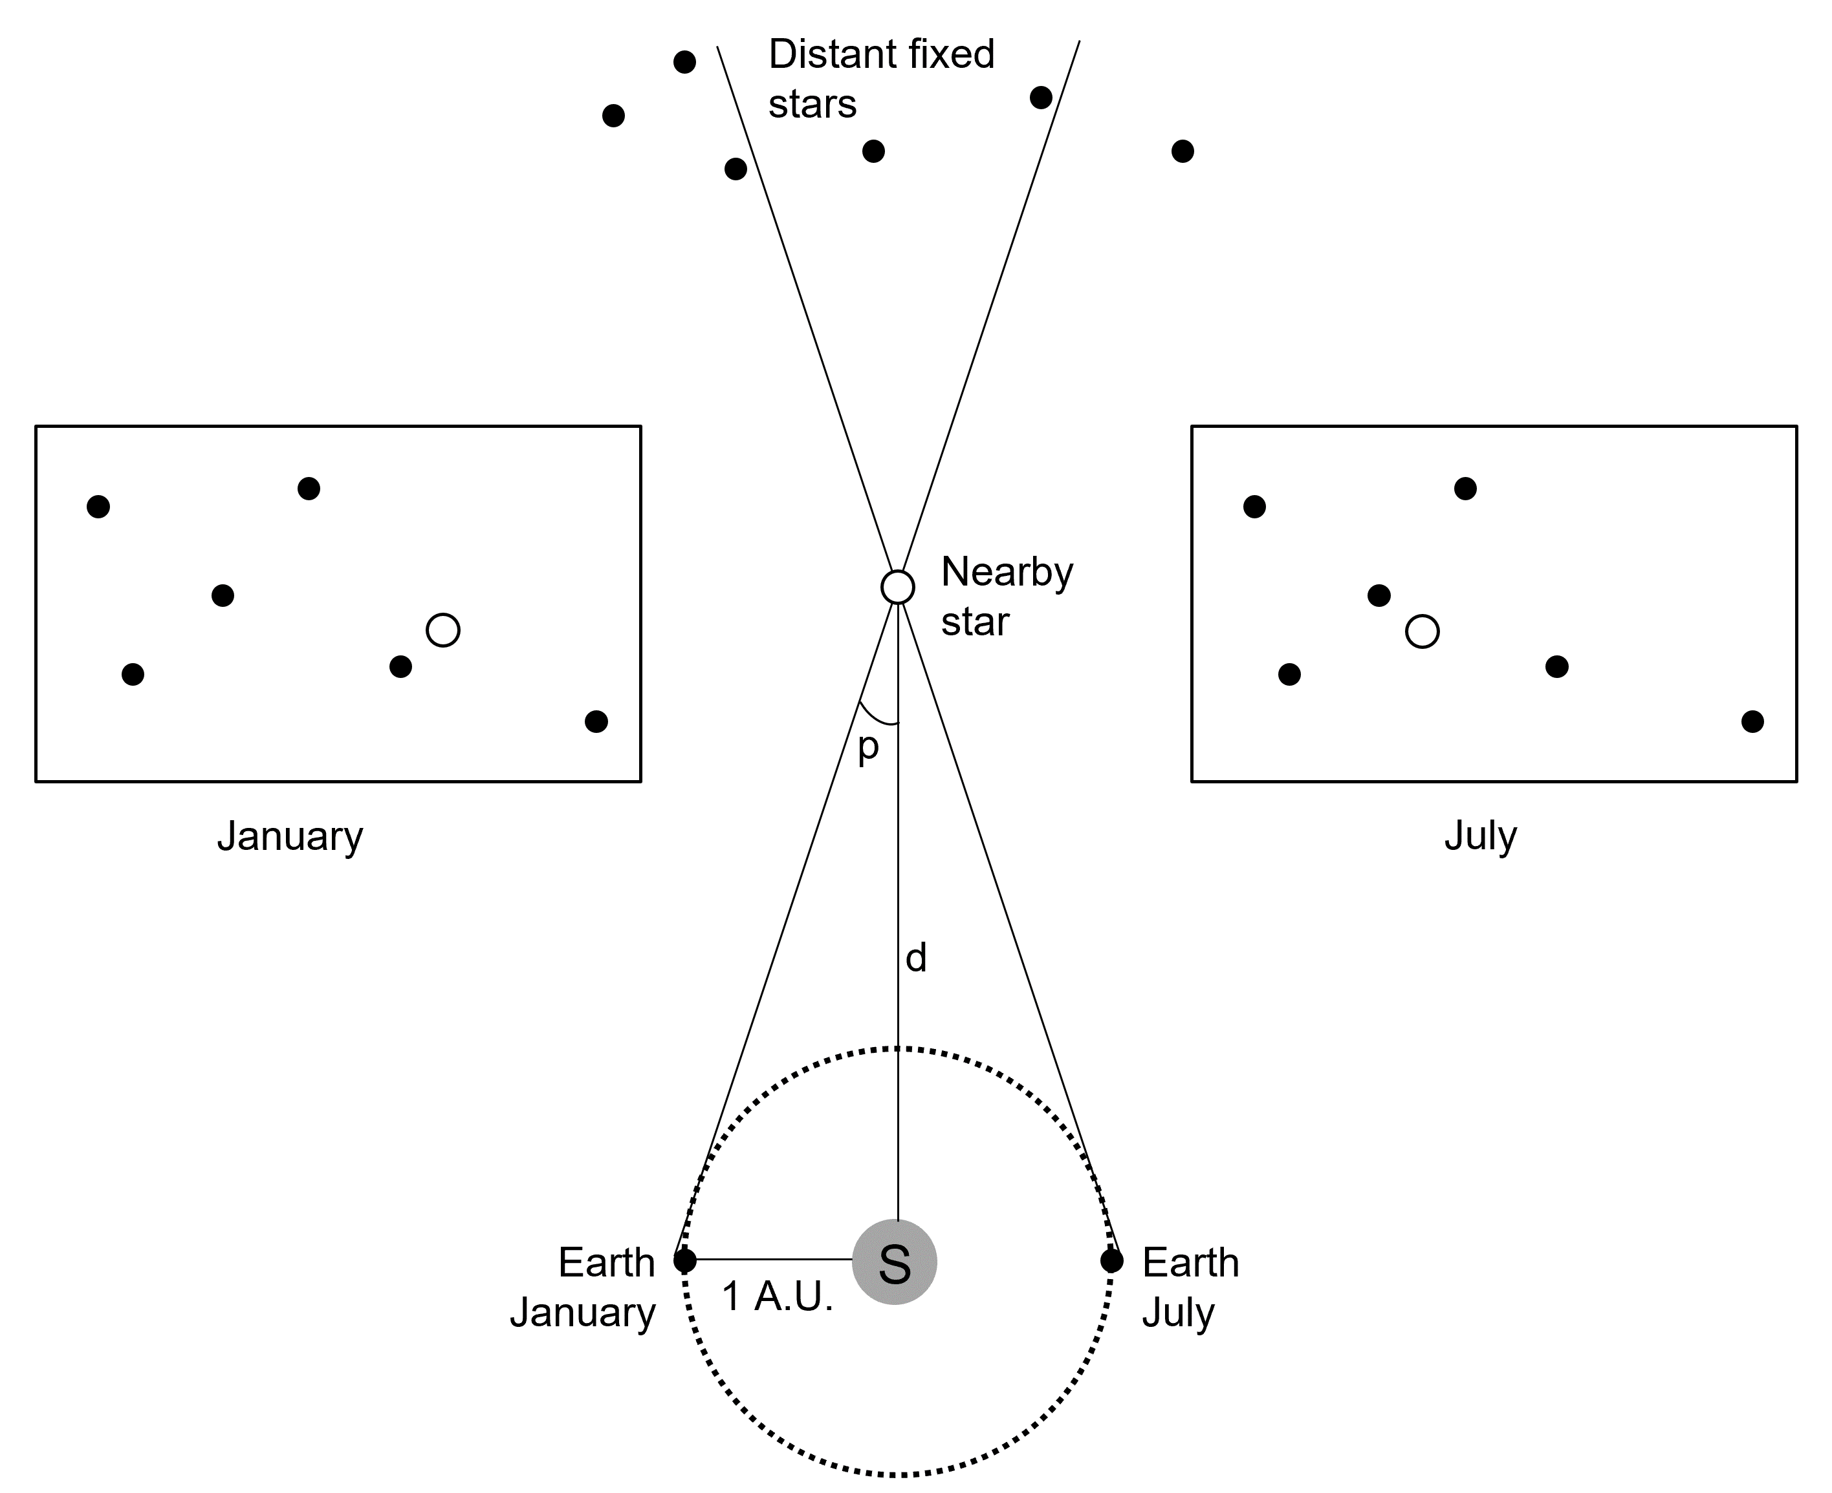
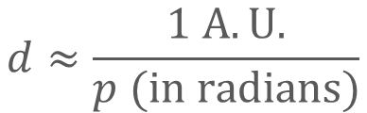
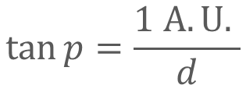
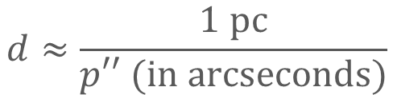
Distance measurement II: Stellar Parallax
Used to find distance to nearby stars
Measured by locating object of celestial sphere
$$\tan{p=\frac{1 A.U. }{d}}$$
Known value
Distance of interest
$$d≈\frac{1 A.U.}{p (in radians)}$$
$$d≈\frac{1 pc}{p′′ (in arcseconds)}$$

Slide 14
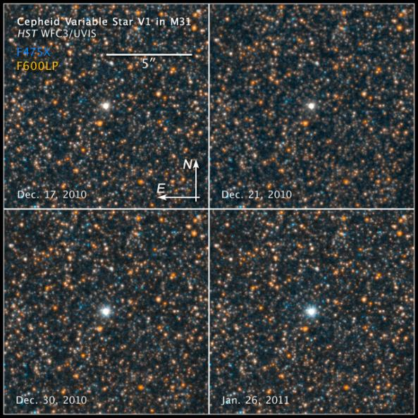
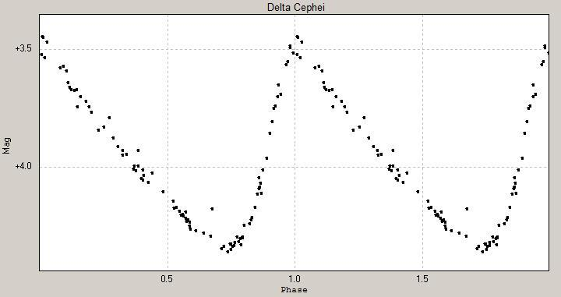
Distance measurement III: Cepheid Variables
Image credit: ThomasK Vbg, CC BY-SA 3.0
Pulsating stars.
Periodic variations in brightness.
http://www.spacetelescope.org/images/opo1115c/

Slide 15
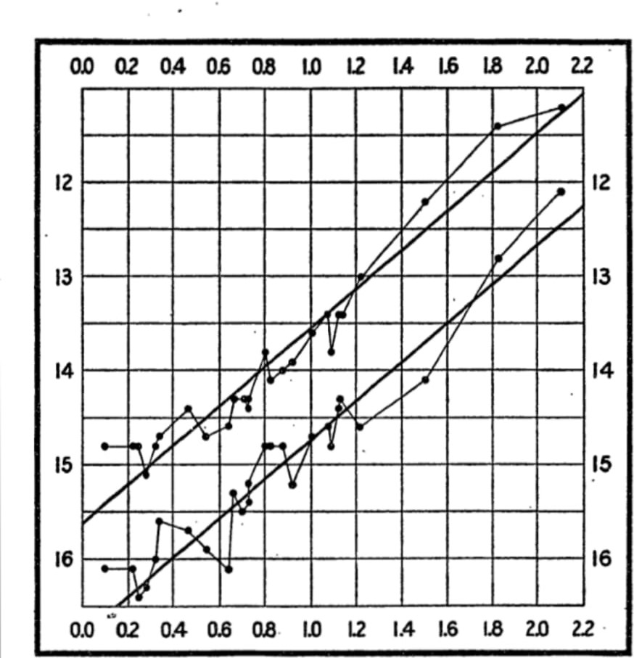
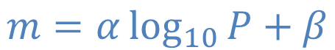
Distance measurement III: Cepheid Variables
Henreitta Leavitt (1912):
Maximum brightness
$$m=α\log_{10}{P+β}$$
Apparent Magnitude of Brightness, m_{V}
Brightness
Period of pulsation
Minimum brightness
Leavitt analysed over 2000 Cepheids in the Small Magellanic Cloud (SMC)!!
Log₁₀(Period of pulsation)
Image credit: Leavitt

Slide 16
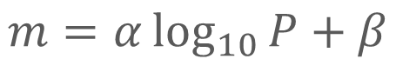
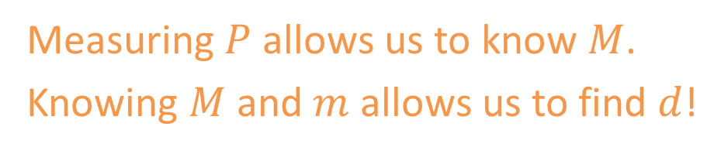

Distance measurement III: Cepheid Variables
Maximum brightness
How to find distance using this?
$$m=α\log_{10}{P+β}$$
Apparent Magnitude of Brightness, m_{V}
Perform a calibration to get:
$$M=a\log_{10}{P+b}$$
Minimum brightness
Measuring $P$ allows us to know $M$.
Knowing $M$ and $m$ allows us to find $d$!
Log₁₀(Period of pulsation)
Image credit: Leavitt

Slide 17
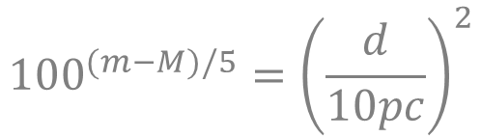
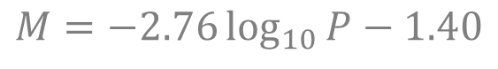
Distance measurement III: Cepheid Variables
Step 1: Calibrating the ruler
By observing nearby Cepheids, we measure their apparent magnitude m and period of brightness variation P.
Using stellar parallax to measure d. Use the brightness – distance relationship to find absolute magnitude M.
$${100}^{(m−M)/5}={\left(\frac{d}{10pc}\right)}^{2}$$
An empirical relation between absolute magnitude and period can be obtained.
$$M=−2.76\log_{10}{P−1.40}$$
Notes:
Skip during lecture. Self reading.

Slide 18
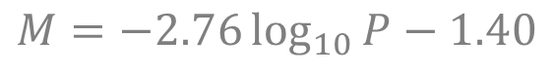
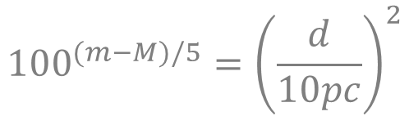
Distance measurement III: Cepheid Variables
Step 2: Using the ruler
Observe and measure the period of pulsation P and apparent magnitude m of Cepheids in a further galaxy.
Find absolute magnitude M using the empirical relationship.
$$M=−2.76\log_{10}{P−1.40}$$
Obtain the distance d of the galaxy using the brightness – distance relationship.
$${100}^{(m−M)/5}={\left(\frac{d}{10pc}\right)}^{2}$$

Slide 19
Distance measurement III: Cepheid Variables
Limitations
Cepheids are bright but not super bright. M ranges from -2 to -7.
Cannot be used as cosmic ruler if they are too far away to be observed!
Current observational limit is about 20 MPc.

Slide 20
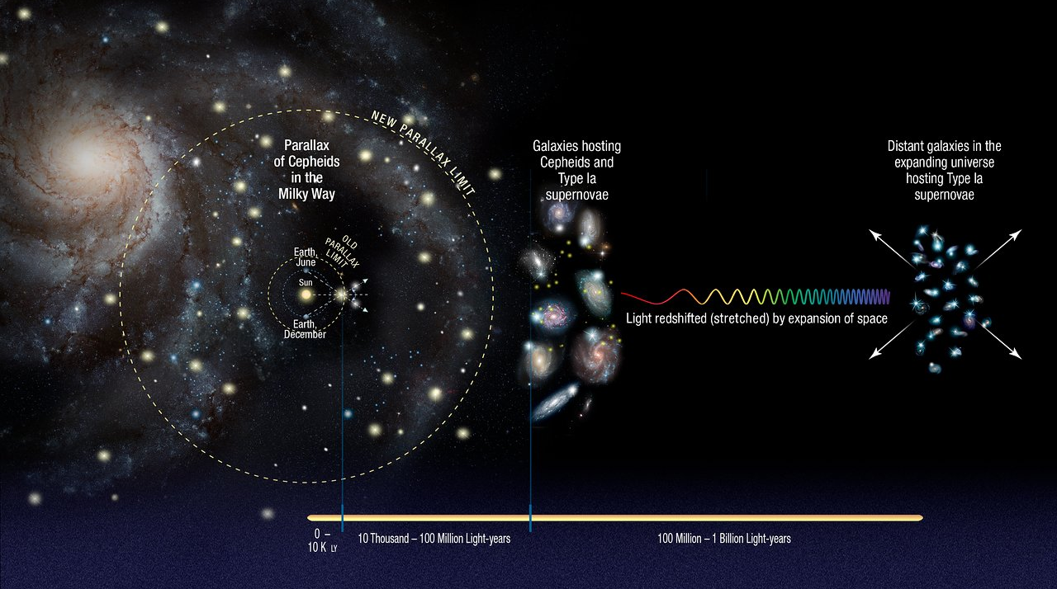
The Cosmic Distance Ladder
Image credit: NASA, ESA, A. Feild, and A. Riess

Slide 21


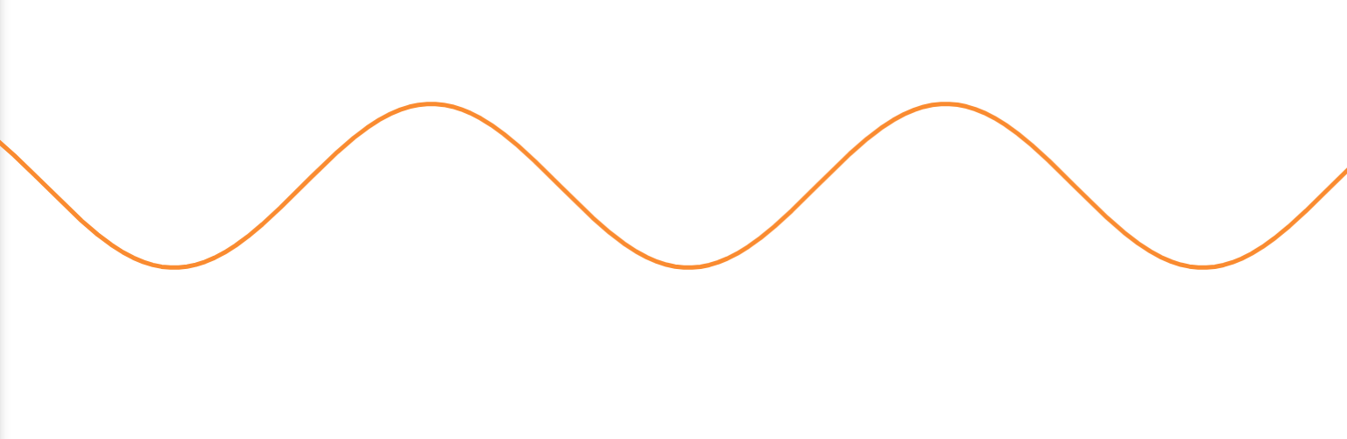
Astrospectroscopy
Split the colours of light from stars!
Cooler atmosphere
Hot interior

Slide 22
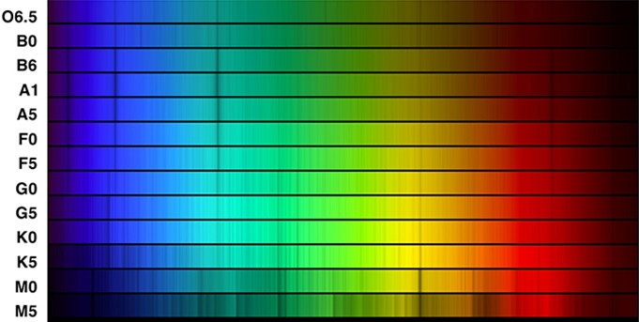
Astrospectroscopy
Stellar spectra tells us info on temperature and chemical composition of stars.
> 25000K. He⁺ lines
11000 – 25000 K. He lines
7500 – 11000 K
Strong H lines
6000 – 7500 K. H lines.
Metal lines begin to show
Our Sun
5000 – 6000 K. H lines.
Metal lines stronger
3500 – 5000 K.
Metal lines dominate
< 3500 K
Molecular bands appear

Slide 23
Astrospectroscopy
More often than not, astrospectroscopy lines are not are where they are “supposed to be” but shifted consistently.
Why?

Slide 24
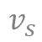
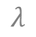
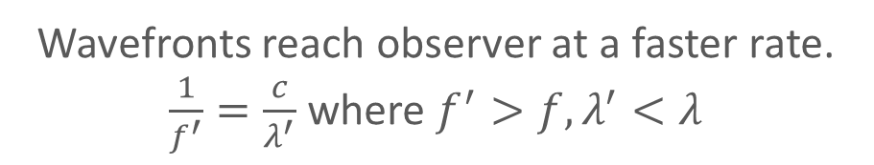
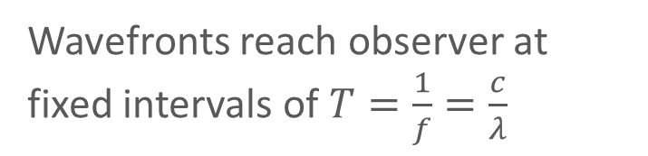
Doppler effect
Stationary source
Source moving towards observer
$$λ$$
$$v_{s}$$
Observer
Source
Observer
Source
Wavefronts reach observer at fixed intervals of $T=\frac{1}{f}=\frac{c}{λ}$
Wavefronts reach observer at a faster rate. $\frac{1}{f^{′}}=\frac{c}{λ^{′}}$ where $f^{′}>f, λ^{′}<λ$

Slide 25
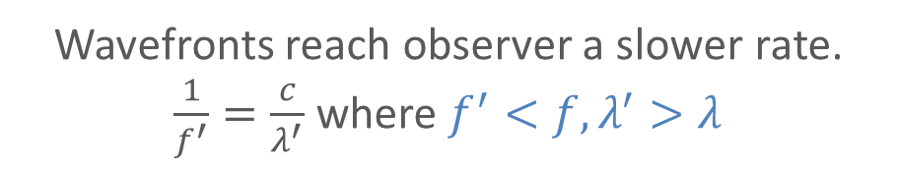
Doppler effect
Stationary source
Source moving away from observer
$$λ$$
$$v_{s}$$
Source
Observer
Source
Observer
Wavefronts reach observer at fixed intervals of $T=\frac{1}{f}=\frac{c}{λ}$
Wavefronts reach observer a slower rate. $\frac{1}{f^{′}}=\frac{c}{λ^{′}}$ where $f^{′}<f, λ^{′}>λ$

Slide 26

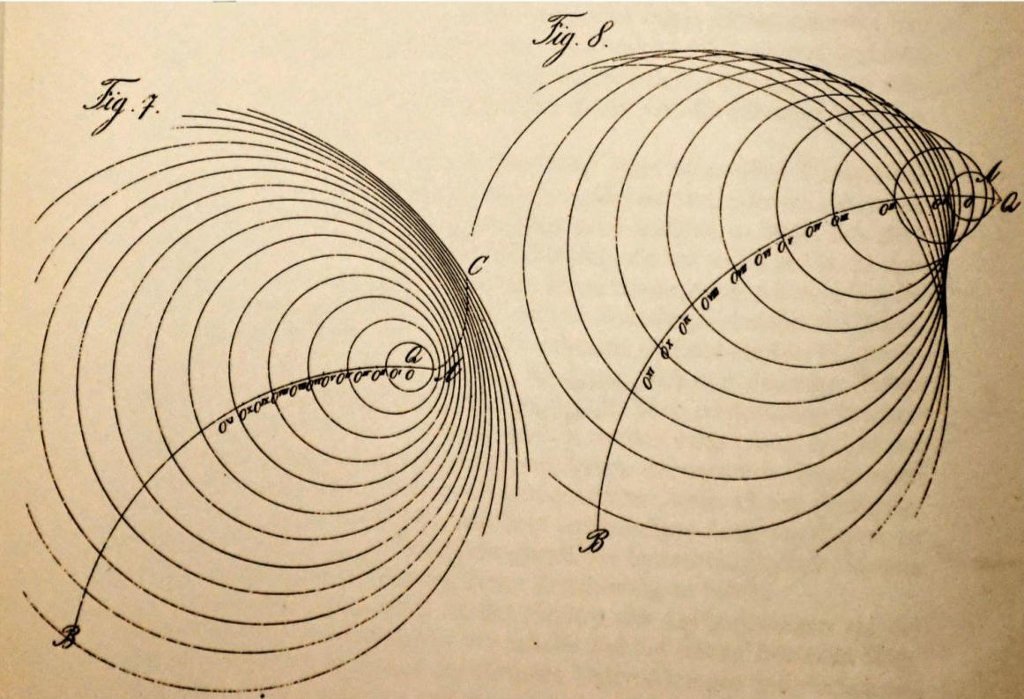
Doppler’s original drawing
These drawings, from Doppler’s 1847 paper illustrate his effect at high speeds and anticipate the Mach cone, which was predicted and photographed by Ernst Mach 40 years later. They also show shock-wave focusing for sources with angular velocity.
(Harvard University Biodiversity Heritage Library)

Slide 27



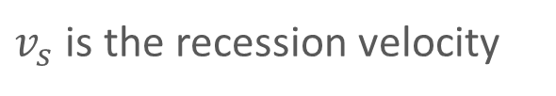
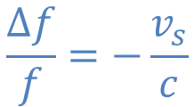
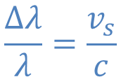
Doppler shift
Observed
$$\frac{Δλ}{λ}=\frac{v_{s}}{c}$$
where $Δλ=λ^{′}−λ$
Emitted
$$\frac{Δf}{f}=−\frac{v_{s}}{c}$$
where $Δf=f^{′}−f$
Observed
$v_{s}$ is the recession velocity
$c$ is the speed of sound

Slide 28

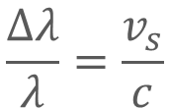
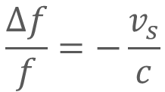
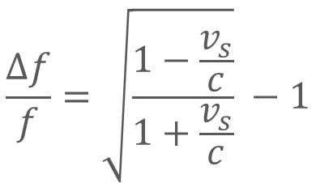
Doppler shift for Light
$$\frac{Δf}{f}=\sqrt{\frac{1−\frac{v_{s}}{c}}{1+\frac{v_{s}}{c}}} −1$$
$$\frac{Δf}{f}=−\frac{v_{s}}{c}$$
when $v_{s}≪c$, the equation reduces to
and equivalently
$$\frac{Δλ}{λ}=\frac{v_{s}}{c}$$

Slide 29
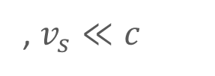



Doppler shift for Light
$$z=\frac{Δλ}{λ}$$
Define redshift $z$
$$z=\frac{Δλ}{λ}=\frac{v_{s}}{c}$$
, $v_{s}≪c$
When source is moving away from us, $v_{s}>0$, $Δλ>0$, the observed wavelength ($λ^{′}$) is thus “reddened”.

Slide 30


Application of Doppler shift: Hunt for exoplanet!
Doppler shift due to stellar wobble
What the spectrum “should be”
Redshifted spectrum
Blueshifted spectrum
Image credit: NASA, MIT

Slide 31




Spectra of galaxies exhibit redshifts
Milton Humason and Edwin Hubble observed redshift of galaxies while using their 100-inch telescope at Mt Wilson.
$$z=\frac{Δλ}{λ}=\frac{v_{s}}{c}$$
, $v_{s}≪c$

Slide 32



Wait, are galaxies moving away from us? Why??
$$v=H_{0}d$$
Data from Hubble’s landmark 1929 paper.

Slide 33


5%
Week 8

